Slide 1

MAVEN TOY SHOP ANALYSIS
TDI PowerBI Capstone Presentation
By: Francis Agbo

Slide 2
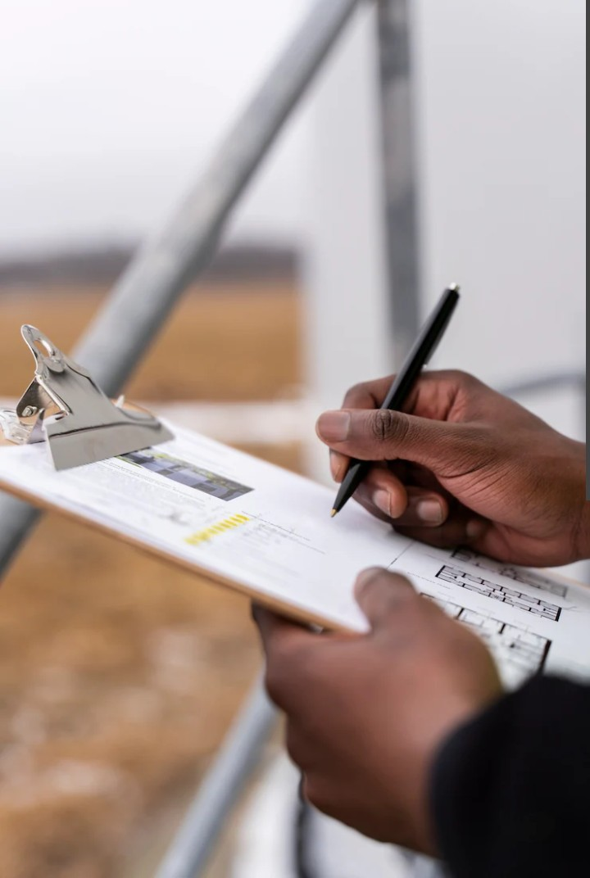
Project Overview
Analyzed sales, profit, inventory, and store performance for Maven Toy Shop across multiple cities in Mexico.
Used Power BI to deliver data-driven insights for optimizing sales strategy, inventory management, and profitability.
Created an interactive dashboard to help executives make informed strategic and operational decisions.

Slide 3
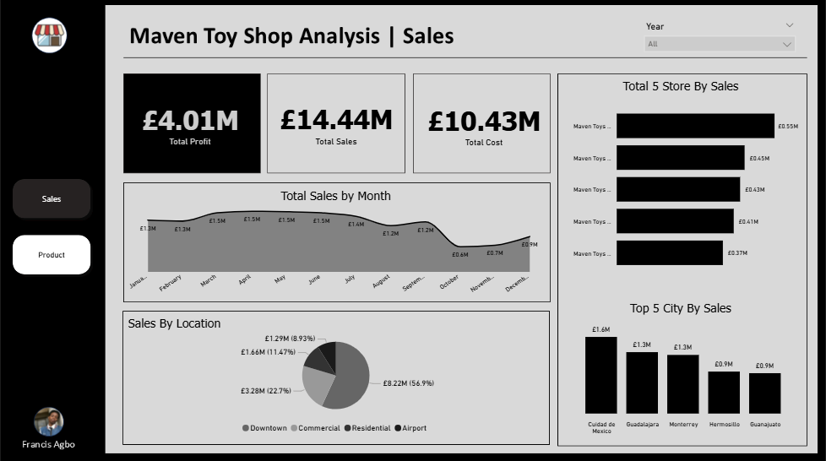
Dashboard Overview

Slide 4
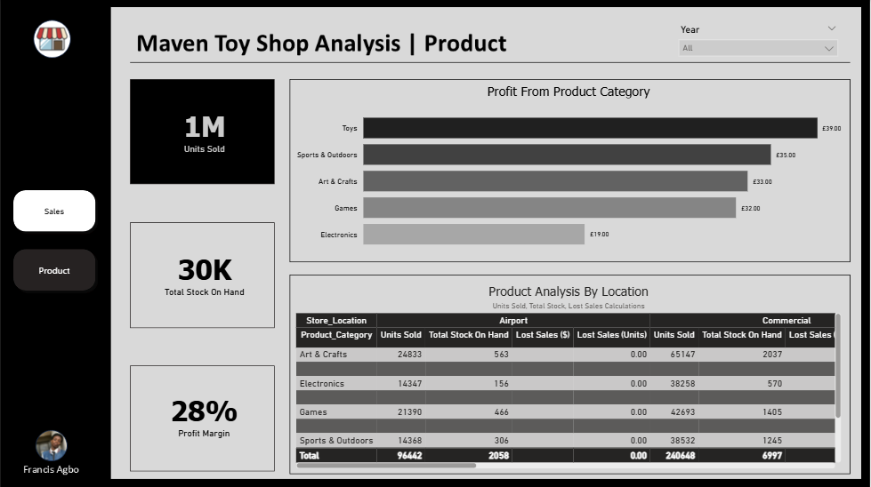
Dashboard Overview

Slide 5

Key
Objectives
Analyze store performance across locations & cities
Product category profitability
Track Lost sales if any
Profit margin analysis
Inventory optimization

Slide 6
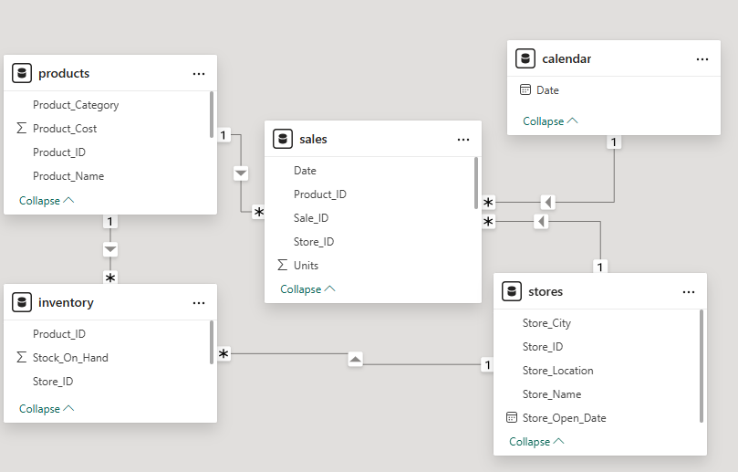
Dataset Structure
The dataset consist of multiple interconnected tables representing stores, sales, products and inventory performance all related with foreign keys.

Slide 7
Methodology
The process of cleaning, analysis and visualization was all carried out using Power BI.

Slide 8
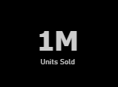
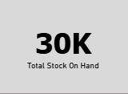
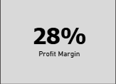
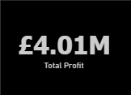
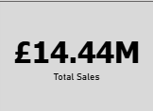
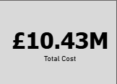
KPIs

Slide 9
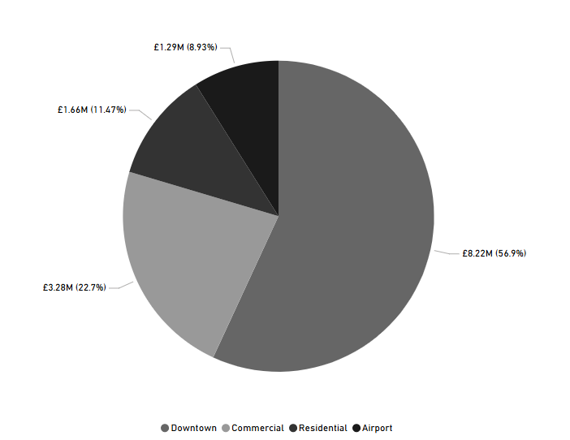
Key Findings
Sales by Location
Downtown: £8.22M (56.9%)
Commercial: £3.28M (22.7%)
Residential: £1.66M (11.47%)
Airport: £1.29M (8.93%)

Slide 10
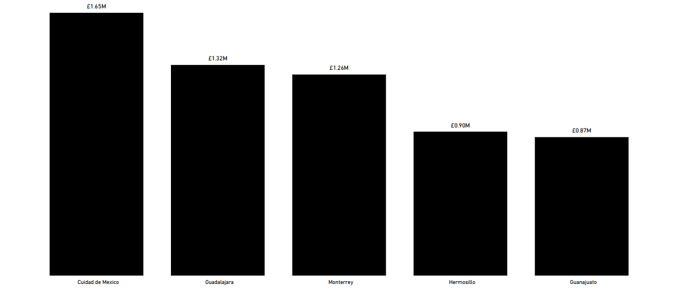
Key Findings
Top 5 Cites Ranked By Sales
Cuidad de Mexico (£1.65M)
Guadalajara (£1.32M)
Monterrey (£1.26M)
Hermosillo (£0.90M)
Guanajuato (£0.87M)

Slide 11
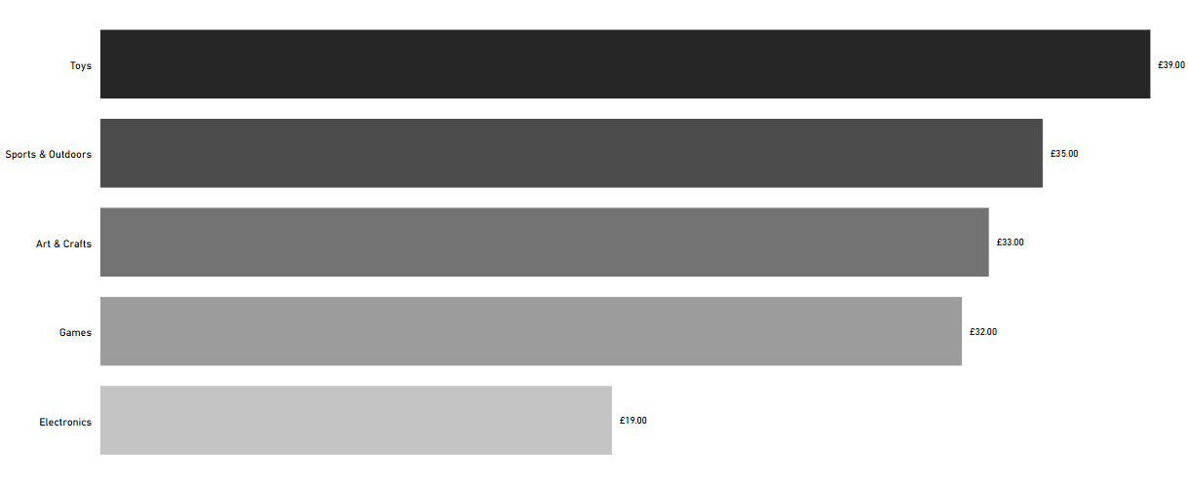
Key Findings
Product By Profitability
Toys: (£39.00)
Sports & Outdoors (£35.00)
Arts & Crafts (£33.00)
Games: (£32.00)
Electronics: (£19.00)

Slide 12
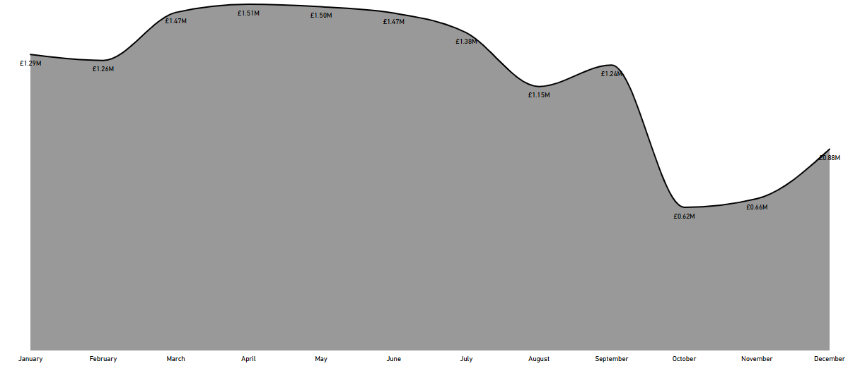
Key Findings
Sales Trend:
Moderate growth early in the year.
Decline between August–September.
Recovery from October through December.

Slide 13

Insights and Recommendations
Prioritize Toys & Sports promotions
Reassess Electronics
Expand Downtown stores
Boost Airport store sales
Improve procurement efficiency
Focus campaigns on high-sales months and adjust inventory pre-emptively.

Slide 14

Conclusion
The analysis reveals that Downtown stores and high-margin categories like Toys and Sports & Outdoors are the core drivers of revenue and profitability for Maven Toy Shop.
Meanwhile, Electronics and Airport stores represent areas with potential for strategic improvement through pricing, promotion, and customer targeting.
Strong inventory performance ensured no lost sales, reflecting operational efficiency and demand alignment.
Moving forward, focusing on high-performing segments and refining underperforming areas will enable Maven Toy Shop to maximize profit potential, strengthen market presence, and sustain long-term growth.

